Slide 1


Principles of Microeconomics Session 1: Upgrading coffee shop talk (Introduction)
Associate Professor Jonathan Tan
j.tan@ntu.edu.sg

Slide 2
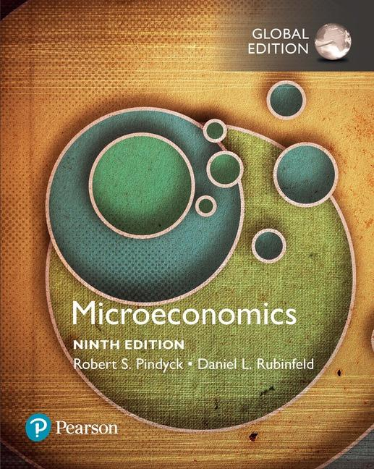
Session outline
Learning objectives
Course content
Assessments
Course policies and contact
Available @ NTU Booklink!

Slide 3
Learning objectives and outcomes
Use suitable microeconomic concepts and theories, aided by behavioral insights, to comprehend and describe economic problems in our everyday lives.
Apply fundamental microeconomic models to analyzing decision making by households, firms, and government, as well as its impact on the market.
Communicate economic reasoning, in speech and writing, across the various levels of decision making.

Slide 4
Sessions and content
Week | Topic | ILO | Readings/ Activities
1 | Upgrading coffee shop talk (Introduction) | 1, 2, 3 | PR Ch.1
2 | Crazy Rich Asians (Consumption) | 1, 2, 3 | PR Ch 3
3 | Crazy Rich Asians (Consumption) | 1, 2, 3 | PR Ch 3
4 | Crazy Rich Asians 2 (Demand) | 1, 2, 3 | PR Ch 4
5 | On the other side of Tuas (Production) Quiz | 1, 2, 3 | PR Ch 6 & 7
6 | Pasar (Market equilibrium) | 1, 2, 3 | PR Ch 2
7 | We the People (Welfare) Midsemester Test | 1, 2, 3 | PR Ch 9
--- | Recess Week
8 | What’s happening on Lazada? (Competition) | 1, 2, 3 | PR 8
9 | Singapore Power! (Monopoly) | 1, 2, 3 | PR Ch 10-11
10 | Playing games (Oligopoly) | 1, 2, 3 | PR Ch 12
11 | Playing smart (Business strategies) | 1, 2, 3 | PR Ch 13
12 | JustGive then Stomp! (Behavioral Economics) | 1, 2, 3 | TBA
13 | TBA | 1, 2, 3 | TBA
22 Nov | Finals
Optimize!
Market outcomes
Business decisions
Behavioral insights

Slide 5

1. Upgrading coffee shop talk
@u: What, why, and how?
Decision making
Market outcomes
Business strategies
Behavioral insights

Slide 6
What? A study of choice, context, and consequence
“Economics is the study of how men and society choose, with or without the use of money, to employ scarce productive resources, which could have alternative uses, to produce various commodities over time and distribute them for consumption, now and in the future among various people and groups in society.” (Paul A. Samuelson, 1955)
Decision makers
Choices
Constraints
Consequences

Slide 7
Themes of Microeconomics
Microeconomics studies how economic agents (consumers, workers, firms, etc) make decisions (choices) in the presence of constraints and tradeoffs:
Limited budget to consume food or clothes
Limited time to work or play
Limited ability to produce using man or machine
Budget, money, time and ability are scarce resources
🡪 @u: how to allocate such resources to obtain the best outcomes?
Notes:
4

Slide 8

Why? To evaluate, predict, or guide choice
Households
Firms
Government
Buy
Work
Play
Invest
Insure
Donate
…
Sell
Produce
Price
Compete
Collude
Innovate
…
Tax
Spend
Regulate
Restrict
Subsidize
Provide
…

Slide 9
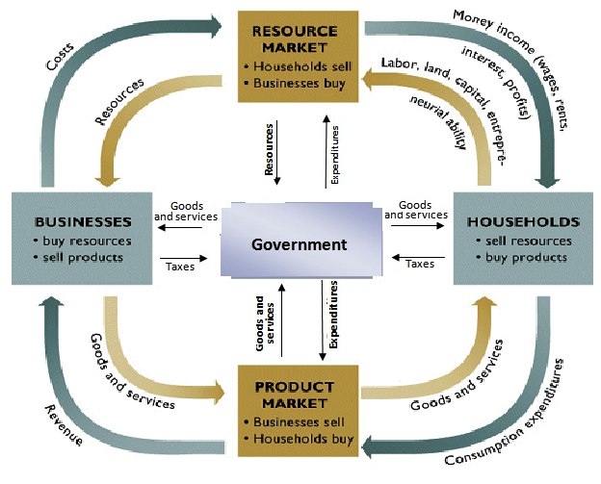
Circular flow model A conceptual model of economic exchange
Source: https://sbhsgovecon.files.wordpress.com/2013/02/02-circular-flow-mixed-economy.png

Slide 10
How? Economics adopts a scientific approach
Observe
“Phenomenon”
Characteristics
Conditions
Choices
Policies
Outcomes
Verify
Test
Hypotheses
Measure
Fit
Causes
Effects
Explain
“Model”
Definitions
Assumptions
Variables
Functions
Results

Slide 11

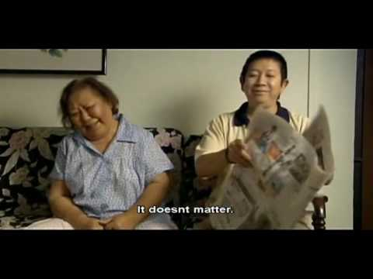
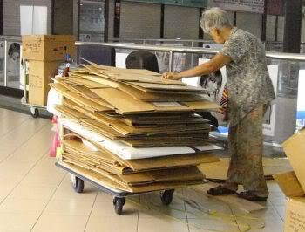
2. Crazy Rich Asians
In what ways do these people differ?
What do they have in common?
Can ONE economic model describe their choices?

Slide 12
Consume
Consumers
Limited incomes
How consumers maximize their well-being (utility), based on their preferences, to make decisions about trade-offs.
@u You are hosting a party. How would you choose what to buy and how much?
Consumer demand for goods can be derived.

Slide 13

Which combination of goods gives the consumer maximum satisfaction subject to his preferences and budget constraint?
Clothing
Bliss point
Indifference curve
Budget constraint
Food

Slide 14
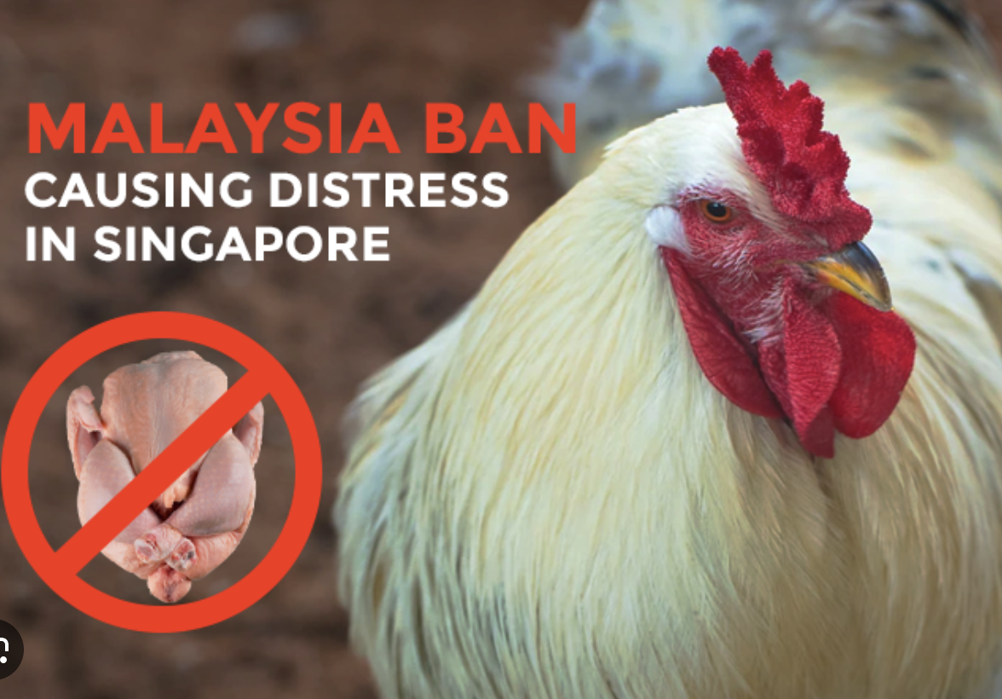
3. Chicken rice crisis
Market demand is an aggregation of individual demand
Effects of price and income changes on different types of goods
Interrelated goods have substitution or complementary effects
@u: How did you react to the price hike in chicken rice during that time?

Slide 15
Demand
P
p
D
0
q
Q

Slide 16
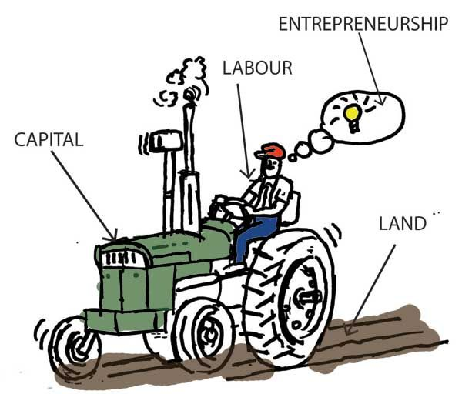
4. On the other side of Tuas

Slide 17
Produce
Firms
How much do firms optimally produce?
Constraints on production capacity & financial resources create trade-offs.
The supply of a good can be derived.
How much capital to invest?
Production technology determines productivity.
How many workers to employ?
Labor demand can be derived.
Notes:
7

Slide 18
Producing a Given Output at Minimum Cost
Capital
per
year
Q₁ is an isoquant for output Q₁
A
K₁
Q₁
Isocost C₁ shows that the optimal cost
to produce Q₁ is combination K₁L₁
C₁
L₁
Labor per year
Notes:
52

Slide 19
Supply
P
S
p
0
q
Q

Slide 20
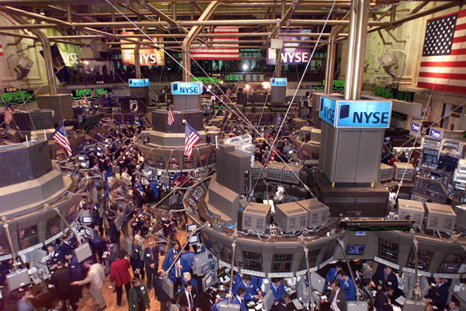
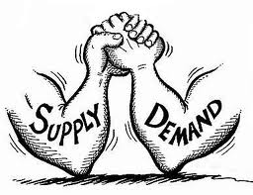
5. Pasar – The Market
SELL HIGH!
P
S
p*
BUY LOW!
D
0
q*
Q

Slide 21
Allocate
Prices 🡪 determines allocation of resources
How are prices determined?
Centrally planned economies – governments control prices
Market economies – prices determined by interaction of market participants
Markets – interaction of buyers and sellers determines the prices of goods.
@u: Give some examples of where such interactions take place

Slide 22
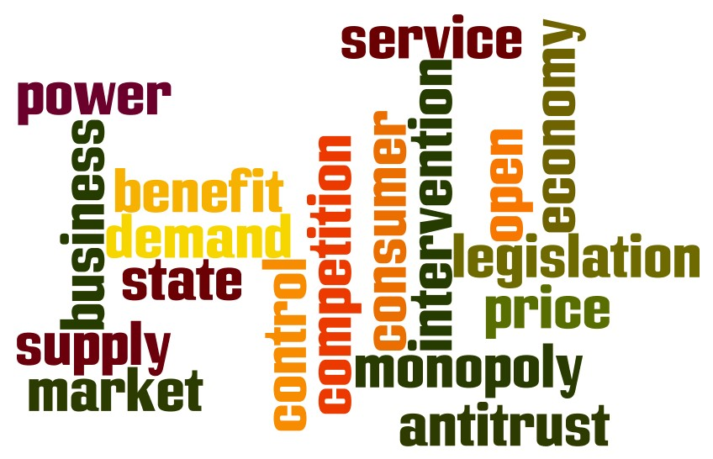
6. We the People

Slide 23
Equilibrium and welfare
The market equilibrium determines welfare distribution
Market outcomes bear efficiency implications for society
The government can leave it to the market or…
intervene with taxes or subsidies, increased or decreased quotas, minimum wages or imported labor…
What should it do?

Slide 24
Consumer and Producer Surplus
Price
Consumer
Surplus
S
Consumers receives a net gain from buying the product -- consumer surplus
5
Producer
Surplus
Producers receive
a net gain from
selling each product --
producer surplus.
D
Q₀
Quantity

Slide 25
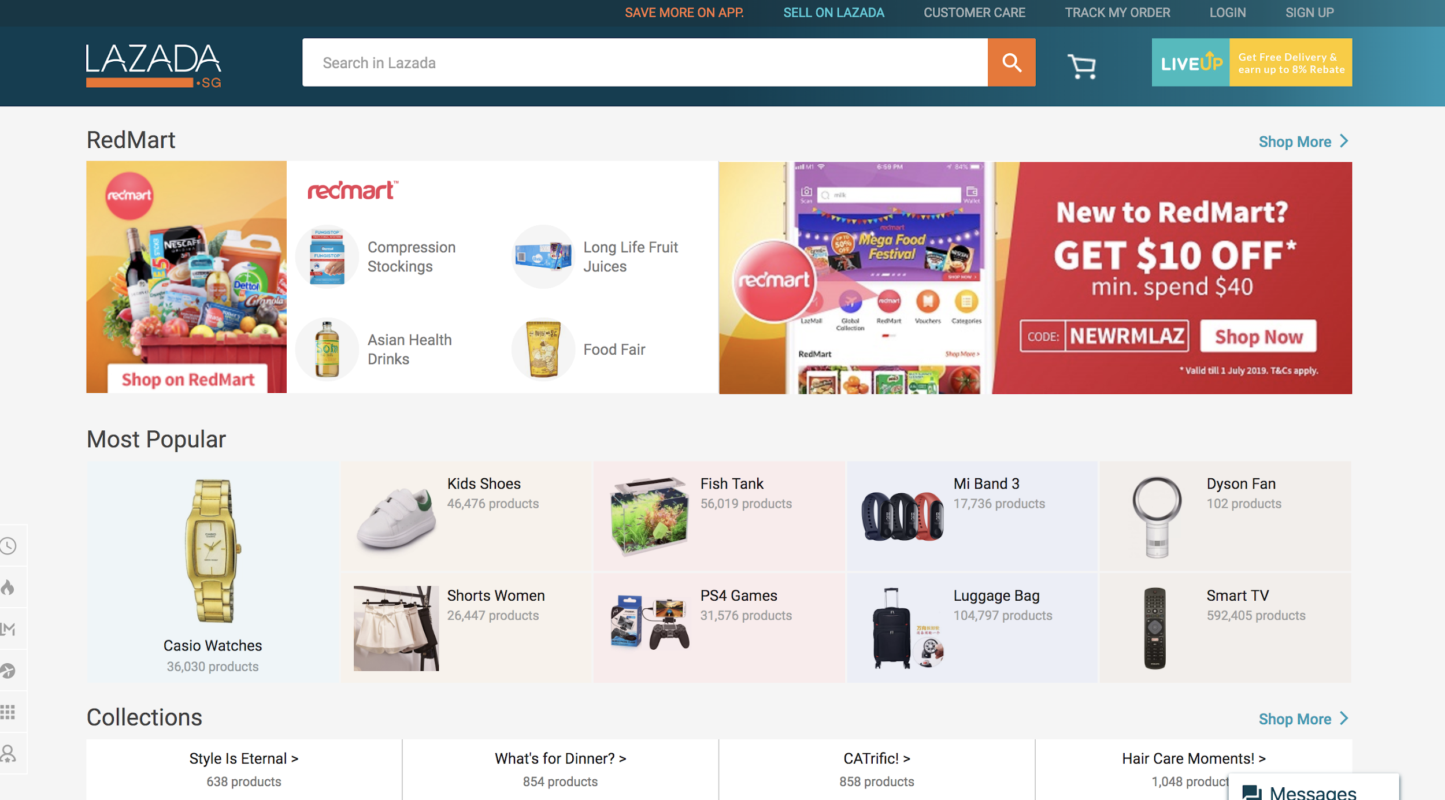
7. What’s happening on Lazada?

Slide 26
Perfect competition Normal economic profits
P
P
S
MC
S’
AC
P*
D
0
Q*
Q
q
Q

Slide 27

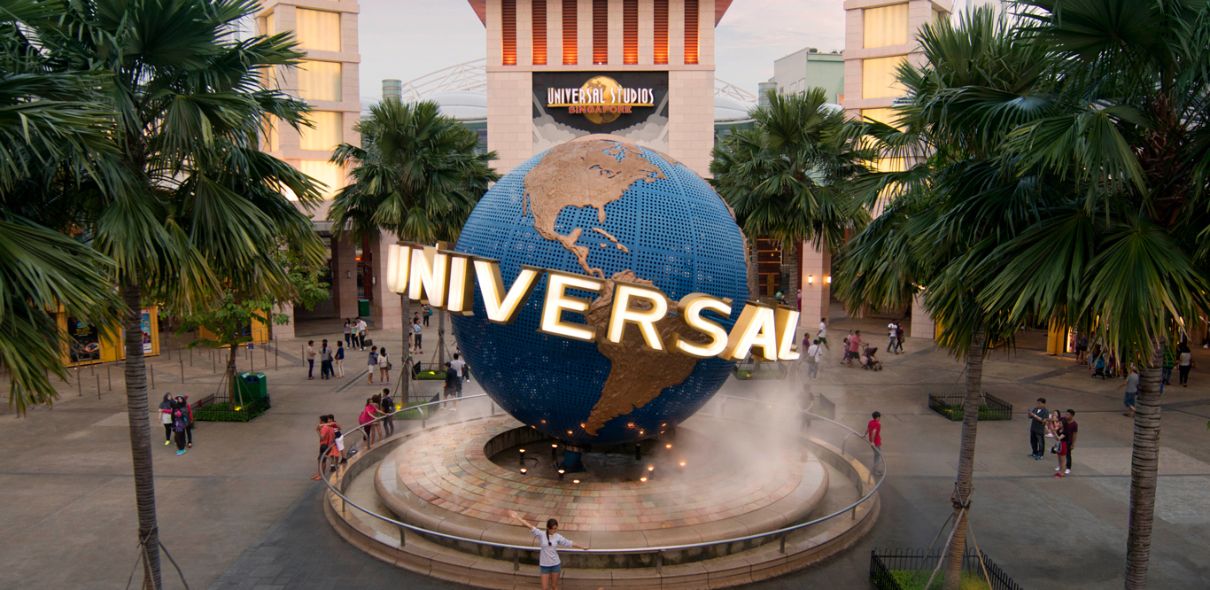
8. Singapore Power!
Click it!

Slide 28
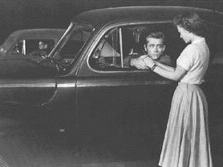
9. Playing games
The James Dean movie Rebel without a Cause popularized a juvenile dare game called ‘chicken’. One version of this dare involves two contenders who resolve a dispute by driving their cars towards each other at high speed on a long, straight stretch of a road. The dispute is resolved when one contender swerves in order to avoid the oncoming opponent and is consequently branded the ‘chicken’. The driver who refuses to relent wins the dare. If both drivers swerve, the game ends in a draw. How can we represent the situation as a game and analyze it?
Click it!
@u: name a footballer and get $1 for every other person who names the same footballer.

Slide 29
10. Playing smart
Time is an important dimension in strategic interactions
Family, colleagues and companies might repeat their interactions
Should we expect more cooperation or better coordination?
How do we model such interactions, predict behaviors, and analyze the conditions under we expect people to cooperate?

Slide 30

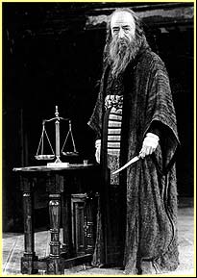

11. JustGive then Stomp!
The old homo oeconomicus is as rational as R2D2…
…more calculative than Shylock,
…and as selfish as Scrooge.
Behavioral economics scrutinizes these assumptions and the effects of relaxing them.

Slide 31
Assessment
Participation (10%)
Active attendance
Present tutorial answers on projector or board
Quiz (10%) – bring your laptops!
Week 5, 30min
Multiple choice questions – covers material from weeks 1-3 (consumption)
Midsemester test (30%) – bring foolscap paper, pen, calculator
Week 7, 60min
Conceptual and problem solving questions – covers material from weeks 1-5
Finals (50%)
22 Nov, 2.5h
MCQ and composite questions – covers material from week 6-13

Slide 32

Course policies and contact
Attendance and assessment – see course outline
Course support: contact me (Weeks 1-7), He Taisen (Weeks 8-13), respective tutors (tutorial groups)

Slide 33
Tutorial 1
Read my Straits Times Opinion Article “Upgrading coffee shop talk” handout
Pick one topic that we will be covering in this course – then think of a matching real world example
Figure out how we can use economics to analyze it, so as to improve decision making
You will have around 5 min per person to present your analysis in class

